Slide 1
SAIN sbAy.t anx.t n.t jA.t nTrj.t the Living Scroll of the Sacred Mounds
Notes:
Saintly texts, imitate the pronounciation of saintly
Living – interactive, functions, visualized, on webpage
Sacred mounds – topic

Slide 2
Study subject: sacred mounds
The Sacred Mounds (jA.t nTrj.t)
Defination by the shape: a heap/bump over the ground – a height
Religious function: burial place of primeval/local gods across Egypt where they could be revived
key features:
Space: a fixed point can be circled
Inside: a dark place
Outside: engage with the movement of the stars and the floodings
Above the ground: a mound
Below the ground: possibly a grave
Time: periodical and cyclical
Interaction: step upon/move about/lie down inside of it
Surroundings: Watery place/sacred trees

Slide 3
Traditional way (Without digital technology)
Find out some of the texts including such sacred mounds from several typical temples as a case study
Transliterate, translate the texts
Interpret the texts with theological facts and find out how local religious concepts influence those texts
Analysis focused on:
The nominal list of the concept “Sacred Mounds”
Lack of analysis for adjectives, adverbs and verbs used to describe such mounds in texts.
Exactly parallel texts (texts with exact same expression from different temples across Egypt)
The standard for parallel is too strict to make a wider range of comparison of texts focused upon the sacred mounds

Slide 4
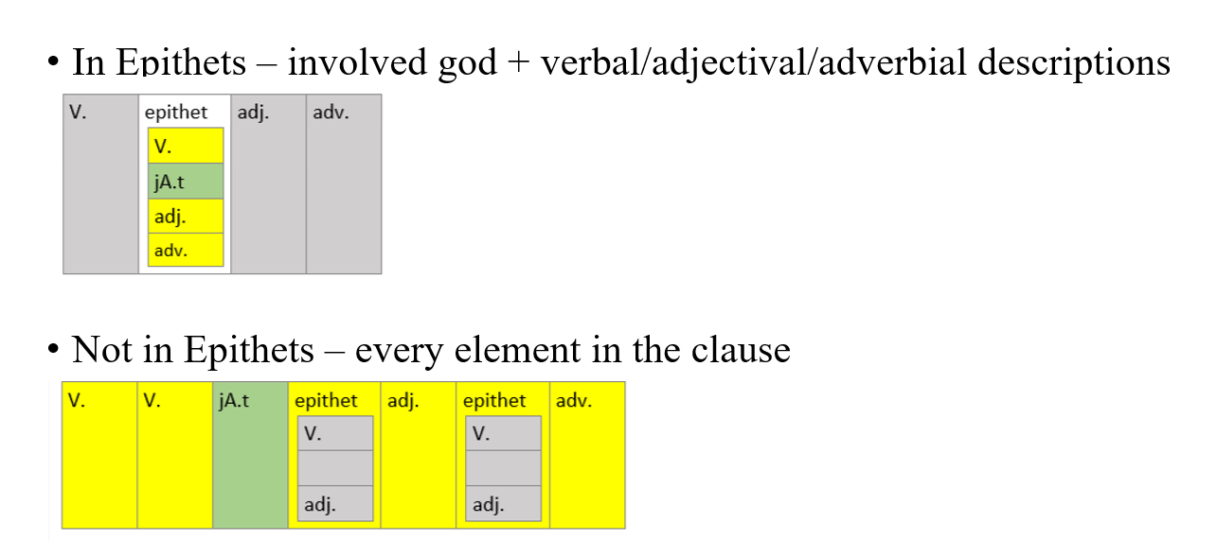
What I want to analyze-1
How are the sacred mounds described?
Adjectival, adverbial, verbal elements involved in the texts where the sacred mounds appear.
Does the word-choice for these descriptive words have a preference in specific regions and specific periods?
Find out the pattern of describing such sacred mounds
Word network analysis, Keyword analysis, Collocation, Frequency list

Slide 5
What I want to analyze-2
Egyptians like to refer to the same thing with different names.
Are there some other temple structures or natural structures that are indeed considered as a kind of sacred mounds by the Egyptians but are not called a “mound” or given specific mound names (DmA)? How can we spot them out?
1. classify related structure names
A-mounds: ascertained to be the mounds, directly called xx jA.t xx or give a specific name (which is attested to be a mound name)
E-mounds: equated to the mounds (equation is directly expressed in original Egyptian texts, like “a sanctuary of God A is the mound of the location B”)
K-mounds: possess certain key features of the sacred mounds, comparable to the sacred mounds
2. testify
1. the pattern of descriptive words about A-mounds have been established (in previous page)
2. test whether E-mounds’ descriptive words have the same pattern
3. if the pattern of a certain kind of E-mounds’ descriptive words is alike that of the A-mounds, then we can say this specific K-mound could be a real sacred mounds in certain context.
Notes:
Problem: 1. how I define the key features are quite arbitrary, whether a kind of structure can be a possible thing comparable to the sacred mounds is really according to my own judgement, a flaw/defect of the study
2. How can we describe the “alikeness” of patterns? In which degree of alikeness of the patterns can assure to the comparability between a temple or natural structure and a sacred mound. What I tend to do is to use statistical analysis, but with a lack of examples in hand and problems with the randomness of the text we have, it is hard to make a reall statistical analysis. But we will see what I will get later.

Slide 6
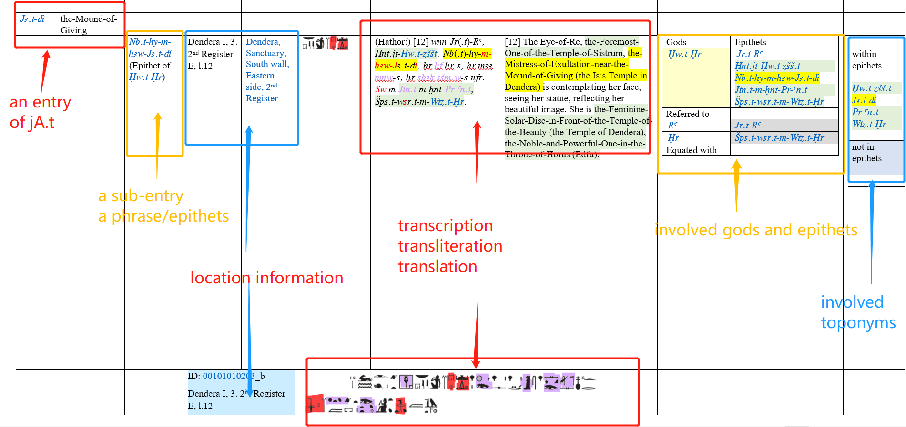
Methods – metadata = a piece of texts with a unique ID, location, *period(later added), *Motif, original image/transcription, transliteration, translation, *layers of word roots, semantical groups, divine elements (gods and epithets/toponyms/others)

Slide 7
Methods-word layers
Manually defined layers specialized for my study (UAM Corpus tool or other tools)
Transliteration
word roots (without grammatical information)
To discuss which word root is used most frequently to represent one semantical meaning
E.g., V_see, xf, mAA, sbAq, “see”, “contemplate”, “reflect”
Translation
Semantical meaning groups for involved description(V., Adj., Adv.) (e.g. V_see, xf, mAA, sbAq, “see”, “contemplate”, “reflect”; V_wake, rs, “wake”)
To see which semantical meaning is most frequently used in each kind of parts of speech (V., Adj., …)
To see the semantic preference
involved divine elements
Epithets + gods
E.g. Jr.t-Ra can refer to unspecified god, 1w.t-1r-wr.t, 1w.t-1r, etc.
Involved divine toponyms
A/E/K_mound_toponym
other sacred elements (names of sacred trees, snakes, water zones)
Notes:
Semantical group see/comtemplate/reflect
Word, xf, mAA, sbAq,
Orthographical writing/hieroglyphic words codes, xf_A/B/C, mAA_A/B, sbAq_A/B/C/D (might be further groupings)
Problem: division of semantical group is quite arbitrary and sometimes the boarder line is blurry

Slide 8
Example-word layers
Transliteration
With capitalization (for publication): wnn (^)jr.t-ra, (^)xnt.jt-(^)Hw.t-zSSt, (^)nb(.t)-hy-m-hAw-(^)jA.t-di.t, Hr xf Hr=s, Hr mAA mnw=s, Hr sbAq sSm.w=s nfr, sw m (^)jtn.t-m-xnt-(^)pr-an.t, (^)Sps.t-wsr.t-m-(^)wTz.t-Hr.
Without capitalization information (for analyzing): wnn jr.t-ra, xnt.jt-Hw.t-zSSt, nb(.t)-hy-m-hAw-jA.t-di.t, Hr xf Hr=s, Hr mAA mnw=s, Hr sbAq sSm.w=s nfr, sw m jtn.t-m-xnt-pr-an.t, Sps.t-wsr.t-m-wTz.t-Hr.
word roots
Wnn jr.t-ra, xnt-Hw.t-zSS.t, nb-hy-m-hAw-jA.t-rdi, Ø xf Hr Ø, Ø mAA mnw Ø, Ø sbAq sSm Ø nfr, Ø m jtn.t-m-xnt-pr-an, Sps-wsr-m-wTz.t-Hr
Ø for grammatical elements with no semantical meaning and pronouns which are not included in discussion
Translation
As long as the Eye-of-Re, the-Foremost-One-of-the-Temple-of-Sistrum, the-Mistress-of-Exultation-near-JA.t-di (the Isis Temple in Dendera) is contemplating her face, seeing her statue, reflecting her beautiful image, she is the-Feminine-Solar-Disc-in-Front-of-the-House-of-the-Beauty (the Temple of Dendera), the-Noble-and-Powerful-One-in-the-Throne-of-Horus (Edfu).
Semantical meaning groups for involved description(V., Adj., Adv.) (e.g. V_see, xf, mAA, sbAq, “see”, “contemplate”, “reflect”; V_wake, rs, “wake”)
V_be N_eye-NG_Re, PREP_before N_temple-N_Sistum, N_lord-V_hy-PREP_near-N_mound-V_give, V_see N_face, V_see N_Statue, V_see N_image ADJ_beautiful, PREP_as N_solar disk-PREP_before-N_temple-ADJ_beautiful, ADJ_noble-ADJ_powerful-N_throne-NG_Horus.
V-verb, N-Noun, NG-noun of god name, PREP-preposition, ADJ-adjective
involved divine elements as marks
Involved gods and epithets: jr.t-ra, xnt.jt-Hw.t-zSSt, nb(.t)-hy-m-hAw-jA.t-di.t #Hwt_Hr_wrt
Involved divine toponyms: Hw.t-zSSt #Temple_E, jA.t-di.t, #A_Mound_E, pr-an.t #Temple_E (_E means being within epithets, without this ending means being outside of epithets)
other sacred elements (names of sacred trees, snakes, water zones): not applicable here
Notes:
Semantical group see/comtemplate/reflect
Word, xf, mAA, sbAq,
Orthographical writing/hieroglyphic words codes, xf_A/B/C, mAA_A/B, sbAq_A/B/C/D (might be further groupings)
Problem: division of semantical group is quite arbitrary and sometimes the boarder line is blurry

Slide 9
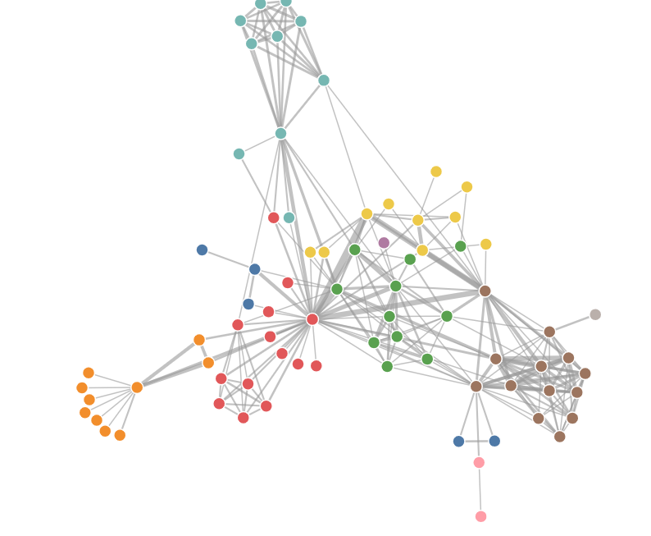
Methods-visualization 1
Network analysis
Represent words as nodes
Connection between words are represented as bonds between the nodes
Each word node have a word homepage
A word homepage include information of the transliteration(jA.t)/translation (mound)/the transcription (orthographical variations jA.t_A/jA.t_B/jA.t_C)/Semantical group(N_mound)/Divine elements(A-Mound)
Metadata are shown as tags (another kind of nodes) associated with the word nodes
Create homepage for these metadata tags
The quantity of attached metadata tags to a word node decide the size of it
with filter for location/region/motif, the size of the shown word nodes = the quantity of the hits
Interactive features
Tags can be hidden or not
Filter: Change the time spans, region spans and motifs of the shown metadata nodes
Precondition: all information is embedded in each piece of metadata texts
Function: compare texts on word level in different span of time and region and within specific motifs flexibly
Notes:
Even my plan of statistical analysis fail, at least I can have this interactive database, and that is kind of fun.
Learn from examples from D3.js, Data-Driven Documents, website, show how to make force-directed graph?
Java script?? Visulization??
Other ways?

Slide 10
Methods-visualization 2
Mapping of words distribution and preference
Targeted for the data describing one or certain kinds of mounds
For example,
For all the data about the mound jA.t-di, we select a semantical group “see” as the topic this time
Within this group we have variations of Egyptian roots: xf, mAA, sbAq
These three Egyptian word root are given three colors
Select the data we want to access – oabout which kinds of mounds the selected texts are describing
select time and location span
see how dots with these three colors are distributed around Egypt
Each dot is clickable – linked with the metadata webpage
compare topographically and chronologically and make analysis
On orthographical level, how is the word xf spelled in different locations? Like xf_A1, xf_A2, xf_A3, xf_B1, xf_B2, xf_C1?
Repeat similar procedures on the layer of divine elements
E.g. How is a specific kind of mound, or an epithet about the mounds distributed across the Egypt?
Notes:
Semantical group see/comtemplate/reflect
Word, xf, mAA, sbAq,
Orthographical writing/hieroglyphic words codes, xf_A/B/C, mAA_A/B, sbAq_A/B/C/D (might be further groupings)

